Slide 1
Azure fundamentals

Slide 2




Cloud platform
A cloud platform is a marketplace for IT equipment and services
Available services include:
Storage (Databases, file systems, …)
Computing resources
Networking (virtual networks, IP addresses, DNS domains, …)
API subscriptions
…
It is convenient to have a single vendor for all these services. Moreover, this improves compatibility, maintainability and security of the acquired resources.

Slide 3



Cloud development
Three ways to develop and monitor cloud applications
Web interface
Command line interface (CLI)
SDKs and third party tools

Slide 4
Azure portal
Start page for Azure: https://portal.azure.com/
Useful to:
Monitor provisioned resources
Getting started with new resources
Advantage:
Point and click interface → easy to get started
Disadvantage:
Point and click interface → difficult to keep track of provisioned resources

Slide 5

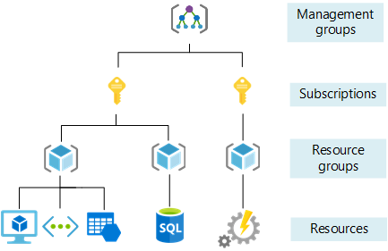
Resource structure
Azure Active Directory - AAD
Manage user accounts for Microsoft products
Office 365
Teams
Azure
Subscription
Billing unit – group all resources that should be invoiced together
Resource group
Group components that belong together
Similar to how you sort files locally in directories to keep an overview
Useful, as permissions can be granted at the level of a resource group
Resources
Individual services bought in Azure

Slide 6
Explore Azure portal

Slide 7
Provisioning resources
Every Azure resource has the following attributes:
Subscription – How is the resource billed
Resource group – In which resource group is the resource located. Most resources can later be moved across resource groups
Name – Name to identify the resource Names should be unique within a subscription. For components that generate an access URL (web pages, storage accounts, …) names should be unique across Azure
Location – Where is the service physically located
Provisioning resources boils down to filling out forms

Slide 8
Provisioning a resource group
Parameters:
Subscription: Azure cursus
Resource group: <your name>
Region: West Europe
Tags:
You can add tags to each resource, which can be used to search/filter for specific resources
It’s a good habit to tag each of the resources you created with your name, such that other people in the subscription know who is responsible for a resource

Slide 9
Provision a storage account
Parameters (basic):
Resource group: Name of the resource group you just created
Storage account name: <your name> no hyphens, spaced and underscores allowed based on the name an URL is generated to access the data in your storage account
Region: West Europe
Performance: Standard Determines how the data is stored in the Azure data center. Premium storage results in higher availability and more rapid data access at an increased cost
Redundancy: Locally redundant storage Cheapest option, our data will only be stored in a single data center. If that data center fails, the data is unavailable.

Slide 10
Provision a storage account
Parameters (advanced):
Security → Use defaults
Data Lake Storage Gen2: Yes Blob storage uses a flat storage system, i.e. there are no folders. When you enable hierarchical namespaces you are allowed to use ‘/’ in file names which mimic a folder structure
Blob storage:
Access tier: Hot The standard service level is further split into three access tiers hot / cool / archive. Cool data storage is cheaper but has longer access delays. For small applications with little data, time won by using the hot tier is more valuable than the extra costs.
Network, data protection & encryption → Use defaults Relevant when you are deploying to a production setting, but not so important during development

Slide 11
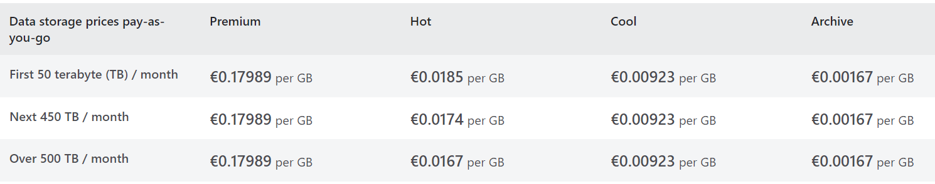
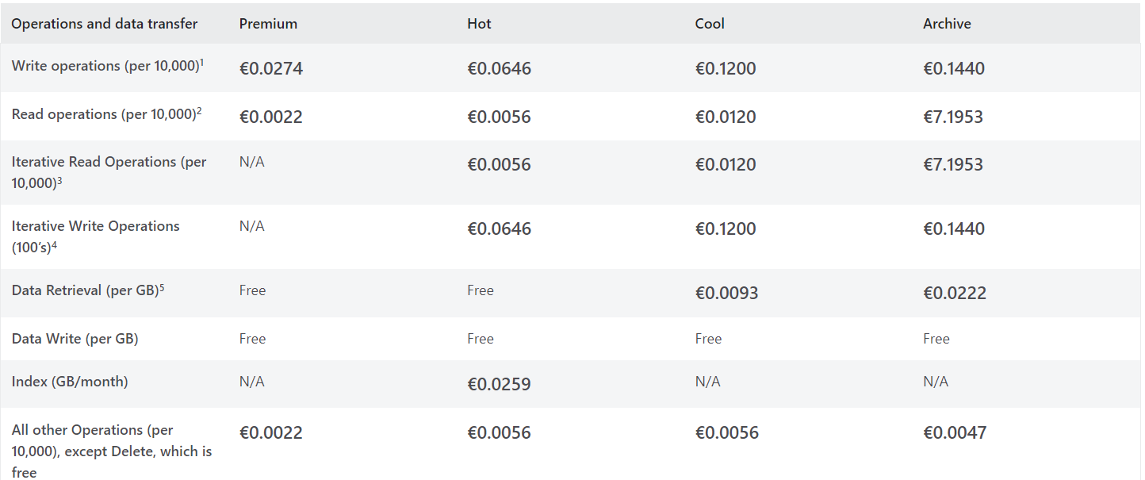
Storage account costs
https://azure.microsoft.com/en-us/pricing/details/storage/blobs/

Slide 12
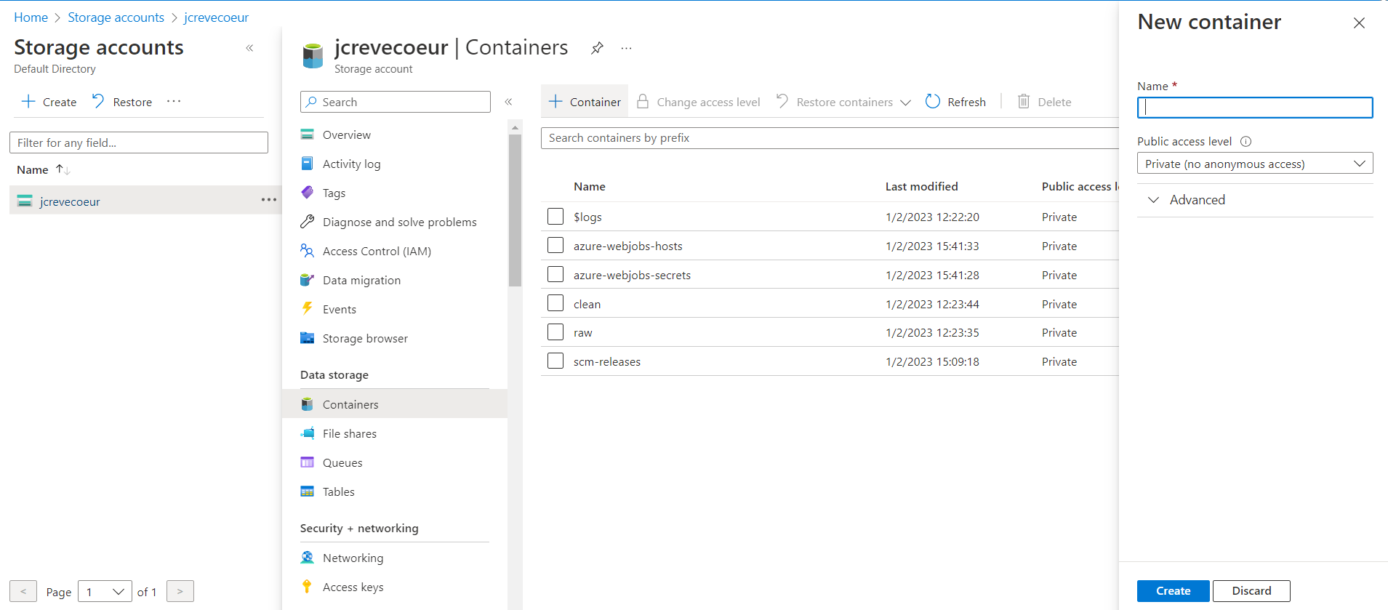
Storage account - containers
Storage accounts support multiple types of storage We use blob storage, which groups files in containers (top level folder)

Slide 13
Data management
Data management becomes more important when working in the cloud:
Applications will create and use files (less overview of the creation process)
Multiple users are accessing the data
More difficult to refactor in an operational setting
Common design:
Raw folder
Clean folder
Master folder
Entry point for new data
Immutable
Cleaned version of the raw folder
Remove duplicate information E.g. when the raw data contains time_utc and time_local only store time_utc
Use for data anlytics
Version of the data to be used by your applications (e.g. website)

Slide 14
Gitpod

Slide 15

Gitpod
Content of the course available on:
https://github.com/jonascrevecoeur/azure-fundamentals
We use Gitpod for developing our application in this course
Gitpod lets users define workspaces as Docker images
You can pre-install necessary software
For this course, the workspace already contains:
The Azure CLI
Azure functions core tools
Python
Gitpod builds and runs this container remotely
You connect and work in this container remotely

Slide 16
Using Azure CLI

Slide 17
Azure CLI commands
Everything action available in the Azure portal, can be performed via the Azure CLI https://learn.microsoft.com/en-us/cli/azure/
az login
Opens an interactive window to authenticate to Azure Active Directory
az account set --subscription <name/ID of the subscription>
Selects the active subscription for future commands. Not required if you only have access to a single subscription
We will be using the Azure storage extension of the CLI. This extension is automatically installed the first time it is used https://learn.microsoft.com/en-us/cli/azure/azure-cli-reference-for-storage

Slide 18
Azure storage CLI commands
az storage container create
Create a storage container within an Azure storage account
az storage blob upload
Upload a new file to an Azure blob storage container
az storage blob list
List files in an Azure blob storage container

Slide 19
Code slide
Make sure you don’t write a space between the variable name, the equal sign and its value
subscription="Azure cursus"
storage_account="jcrevecoeur"
# Read the access key from the .env file, which is not committed to git
export $(grep -v '^#' .env | xargs -d '\n')
az login
az account set --subscription "$subscription"
# upload the file
az storage blob upload \
--account-name $storage_account \
--account-key $account_key \
--container-name raw \
--file data/example.txt \
--name example.txt
# list all files in the container
az storage blob list \
--account-name $storage_account \
--account-key $account_key \
--container-name raw
Quotes are required as the subscription name contains a space

Slide 20
Using the Python SDK

Slide 21
Python SDK
The Azure python SDK is split into many small Python libraries, allowing you to install only those components required.
SDK reference: https://learn.microsoft.com/en-us/python/api/overview/azure/?view=azure-python
For interacting with storage accounts, we need the package azure-storage-blob
We will move a file from the raw to the clean container, to do this we have to:
Authenticate with the storage account using the BlobServiceClient class
Obtain a reference to the source blob that we want to copy
Download the content of the source blob into a string variable
Obtain a reference to the target blob that we want to create
Write the string value from the source blob to the target blob reference

Slide 22
Code slide
# 1. create a virtual environment for storing python packages
python3 -m venv .venv
# 2. activate the virtual environment
source .venv/bin/activate
# 3. install required libraries
pip install azure-storage-blob
pip install python-dotenv
# 4. run the python script to copy the file
# we are actually downloading its content and creating a new blob with the same content
# Copying a blob directly is more complicated
python3 copy_file.py

Slide 23
Code slide
from azure.storage.blob import BlobServiceClient, BlobClient
from dotenv import load_dotenv
import os
load_dotenv()
blob_service:BlobServiceClient = BlobServiceClient.from_connection_string( os.environ.get('connection_string’)
)
source_blob:BlobClient = blob_service.get_blob_client(container='raw', blob='example.txt')
target_blob:BlobClient = blob_service.get_blob_client(container='clean', blob='example.txt')
content = source_blob.download_blob().readall()
target_blob.upload_blob(content, overwrite=True)

Slide 24
Your turn!
Use the Azure CLI to download a file stored in an Azure storage container Azure CLI docs: https://learn.microsoft.com/en-us/cli/azure/storage?source=recommendations&view=azure-cli-latest
Use the Python SDK to list the files stored in an Azure storage container SDK docs on Azure containers: https://learn.microsoft.com/en-us/python/api/azure-storage-blob/azure.storage.blob.containerclient?view=azure-python

Slide 25
Azure functions

Slide 26

Azure functions
Azure functions provides event driven, serverless code execution (equivalent of AWS Lambda)
Triggers:
Time trigger → Run once a day at midnight
HTTP trigger → build an API
File trigger → Run code each time a new file is upload to a certain folder
…
Short execution tasks (max. 5 minutes)
For R, a base docker image has to be provided once (Python, Java, C#, Javascript, powershell, … are natively supported)

Slide 27
Provision Azure functions
Parameters (1/2):
Subscription: Azure cursus
Resource group: <your resource group>
Function App name: <your name>
Publish: Code → Deploy the app as a zip file (alternative use a docker container)
Runtime: Python 3.9
Region: West Europe
Operating system: Linux
Plan: Consumption (serverless) Azure will manage the compute resources for you and scale them based on your demand

Slide 28
Provision Azure functions
Parameters (2/2):
Storage: <the storage account created earlier> Azure will create a container in this storage account to store files required by the function app (e.g. source code)
Networking: Use defaults
Monitoring:
Enable Application Insights: Yes → Azure stores the logs of your function app
Create new application insights with your name
Continuous deployment: disabled → Very useful in practice, to automatically update your function app when the main branch of the corresponding git repository is updated

Slide 29
Construction plan
We will create the following Azure functions:
time: Http endpoint, returns the current time
sum/{a}/{b}: Http endpoint, takes two input parameters and returns the sum
secret/{secret}: Returns the value of the corresponding secret in our keyvault
store_string_in_file/{file}/{string}: Http endpoint, creates a file with name {file} and content {string} in the raw container of our storage account
move_file_from_raw_to_clean: Blob trigger, automatically copies files in the raw container to the clean container

Slide 30
Azure functions core tools
Azure functions core tools provides a CLI for local development of Azure functions
func init
Generates the code for a new function app in the current directory
func new
Add a function to the function app
func start
Run your function app locally
func azure functionapp publish <function app name>
Deploy the local files on Azure

Slide 31
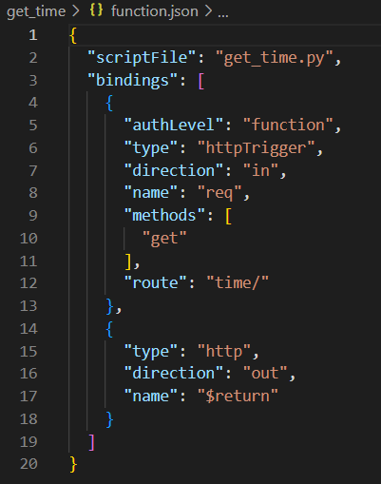
Azure function structure
function.json
Entrypoint for python when the function is trigerred
Run the function when an http endpoint is called (API)
Variable in python that will store the parameters of the request
Allowed methods to call this function. You can include multiple methods or create separate functions per method
URL that triggers the execution of the function
The function returns an HTTP response (response code + response message)

Slide 32
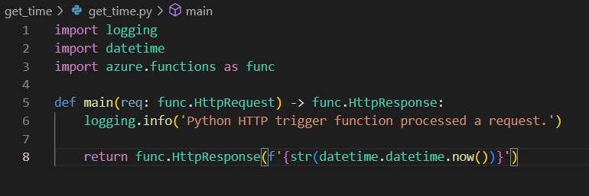
Azure functions structure
Name specified in function.json
Logged in application insights
Return the specified response type. When not specified the response code is 200, OK

Slide 33
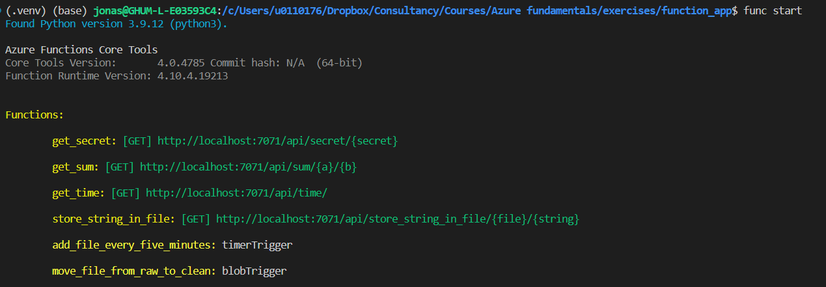
Test function app locally
func start
Run your function app locally
Http endpoint of the function

Slide 34
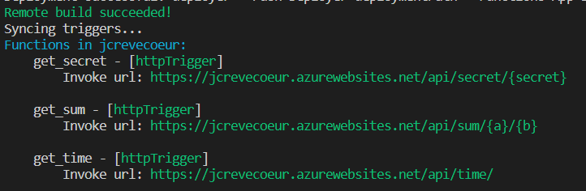
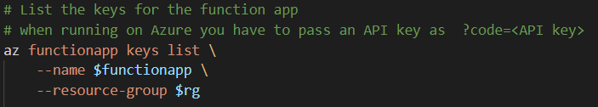
Test function app on Azure
func azure functionapp publish <name function app>
By default, requires authentication (in the form of an API key) for accessing HTTP endpoints
Browse https://jcrevecoeur.azurewebsites.net/api/time?code=<API KEY>

Slide 35
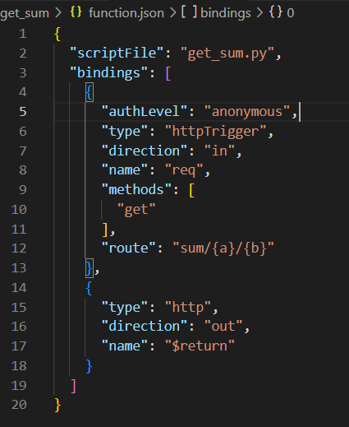
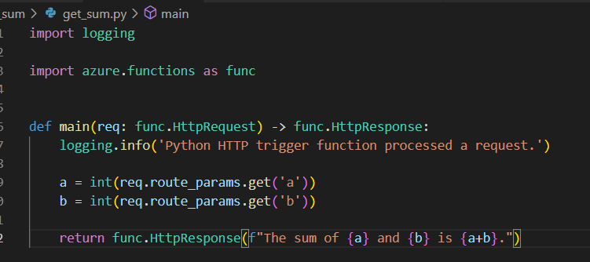
More function settings
AuthLevel: anonymous – don’t require an API key to be passed
Access url path parameters via req.route_params
Include parameters in the URL of the function The function is only triggered when these parameters are supplied

Slide 36
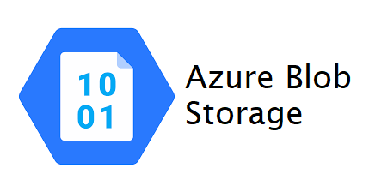

Connecting with a storage account
Connection string
How to authenticate safely?
Don’t store the connection string in Azure functions code Code is uploaded to git & accessible from the Azure portal → A lot of people have access to the stored secret
Locally you can use a .env file (which you add to .gitignore)

Slide 37

Azure key vault
Location to store and manage secrets, keys and certificates
Strict access control of the key vault (limit the number of people who can access a particular secret
Easily rotate a secret, e.g. change the password of the storage account every 6 months. If all applications get their secret from the key vault it has to be updated only in one location

Slide 38
Provision a key vault through the portal
Parameters:
Subscription: Azure cursus
Resource group: <your resource group>
Key vault name: <your name>
Region: West Europe
Pricing: Standard
Purge protection: Disable → When enabled allows you to recover accidently deleted key vaults
Access configuration: Vault access policy → Rules for accessing the keys are defined in the key vault, instead of using the default Azure Role Based Access (RBAC)
Networking → use defaults

Slide 39

Get secret
Define an Azure function (Http trigger) that retrieves a secret from the key vault
First, check access to the key vault using the Azure CLI
Two new libraries for accessing the key vault using the Python SDK
azure-keyvault-secrets → for interacting with secrets stored in key vaults
azure identity → for authenticating to Azure resources
Add these files to requirements.txt, such that they will be installed when deploying the function app on Azure
This is off course a bad idea in practice, but a useful exercise for working with a key vault

Slide 40
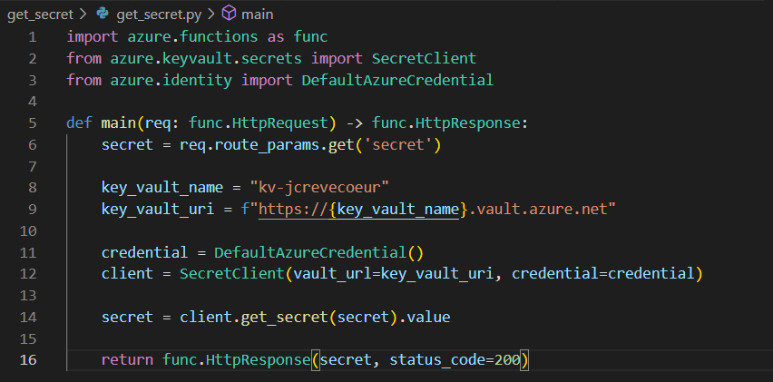
Get secret (continued)
DefaultAzureCredential()
Try different methods to authenticate and use whichever method works
Connect to the key vault. At this moment,
the credentials are evaluated

Slide 41
Code slide – get_secret
import azure.functions as func
from azure.keyvault.secrets import SecretClient
from azure.identity import DefaultAzureCredential
def main(req: func.HttpRequest) -> func.HttpResponse:
secret = req.route_params.get('secret')
key_vault_name = "kv-jcrevecoeur"
key_vault_uri = f"https://{key_vault_name}.vault.azure.net"
credential = DefaultAzureCredential()
client = SecretClient(vault_url=key_vault_uri, credential=credential)
secret = client.get_secret(secret).value
return func.HttpResponse(secret, status_code=200)

Slide 42




Access & security
Role Based Access Control (RBAC):
Identity
Role
“has access to”
Resource
For example:
User: Jonas
Has read access to
A specific Azure blob storage

Slide 43
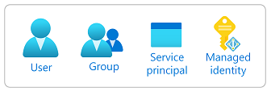
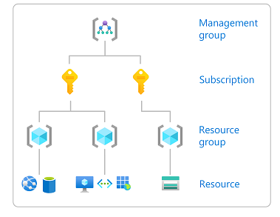
Access & security
Role Based Access Control (RBAC):
Identity
Role
“has access to”
Resource
Principle of least privilege
Principle of least privilege

Slide 44

Azure identity
Assign an identity to Azure functions
Give the assigned identity read access to the key vault
Passwordless authentication
Managed identity

Slide 45
Your turn!
Add an Azure function store_string_in_file with the following properties:
Http trigger, url store_string_in_file/{file}/{content}
No API key required to connect
Create a new file named {file} in the raw container of your storage account with content {content}

Slide 46
Code slide – store_string_in_file
import azure.functions as func
from azure.storage.blob import BlobServiceClient, BlobClient
from azure.keyvault.secrets import SecretClient
from azure.identity import DefaultAzureCredential
def main(req: func.HttpRequest) -> func.HttpResponse:
file = req.route_params.get('file')
string = req.route_params.get('string')
key_vault_name = "kv-jcrevecoeur"
key_vault_uri = f"https://{key_vault_name}.vault.azure.net"
connection_string_secret = "storage-connection-string"
credential = DefaultAzureCredential()
keyvault = SecretClient(vault_url=key_vault_uri, credential=credential)
connection_string = keyvault.get_secret(connection_string_secret).value
blob_service:BlobServiceClient = BlobServiceClient.from_connection_string(connection_string)
destination:BlobClient = blob_service.get_blob_client(container='raw', blob=file) destination.upload_blob(string, overwrite=True)
return func.HttpResponse(f"File created succesfully")

Slide 47
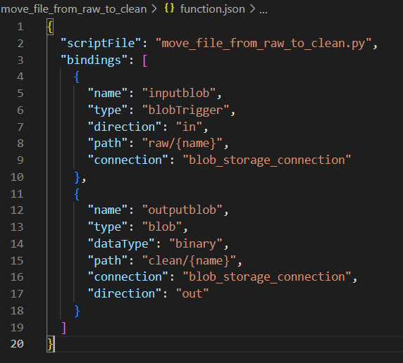
Blob trigger
When a user adds a file to the raw container of the blob storage, automatically copy it to the clean container
Name of the argument in the Python function containing the input file
Files with a name matching this structure are processed
Environment variable/application setting containing the connection string of the storage account
Name of the argument in the Python function containing the input file
Name given to the new output blob

Slide 48
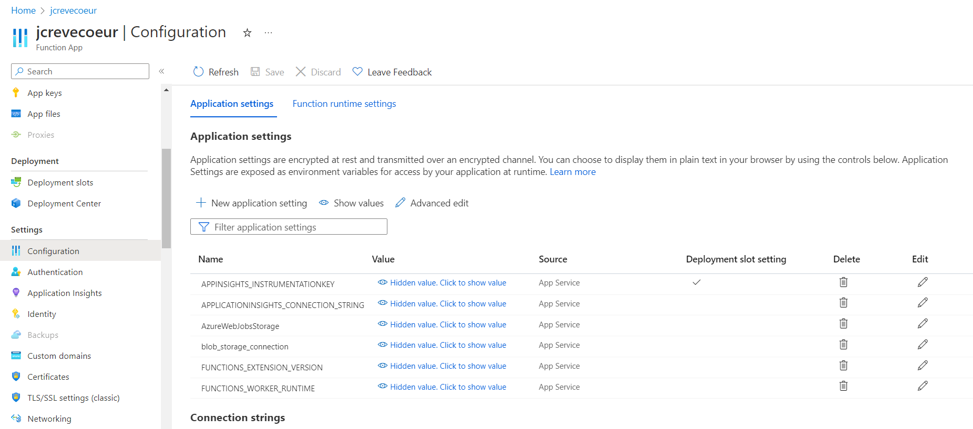
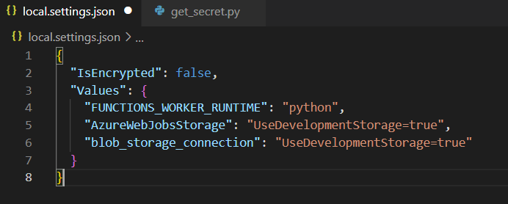
Application settings
Variables created here are available as environmental variables when running the function app on Azure
For debugging locally, you can add variables to local.settings.json

Slide 49
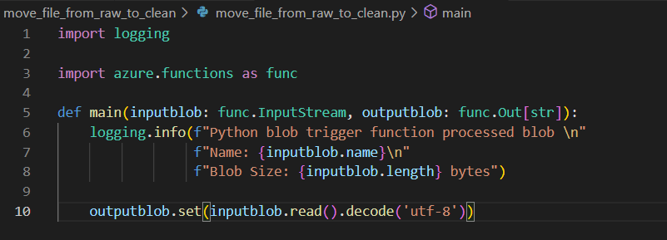
Copy the input blob to the output destination

Slide 50

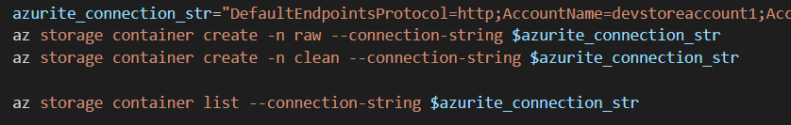
Testing blob triggers locally
To test blob triggers locally we need to emulate a blob storage account → Azurite
Azurite connection string: DefaultEndpointsProtocol=http;AccountName=devstoreaccount1;AccountKey=Eby8vdM02xNOcqFlqUwJPLlmEtlCDXJ1OUzFT50uSRZ6IFsuFq2UVErCz4I6tq/K1SZFPTOtr/KBHBeksoGMGw==;BlobEndpoint=http://127.0.0.1:10000/devstoreaccount1;QueueEndpoint=http://127.0.0.1:10001/devstoreaccount1;
Interact with the emulated storage account using Azure CLI

